Slide 1

Dart Fundamentals: Loops & Functions
Beginner Lessons with Examples

Slide 2

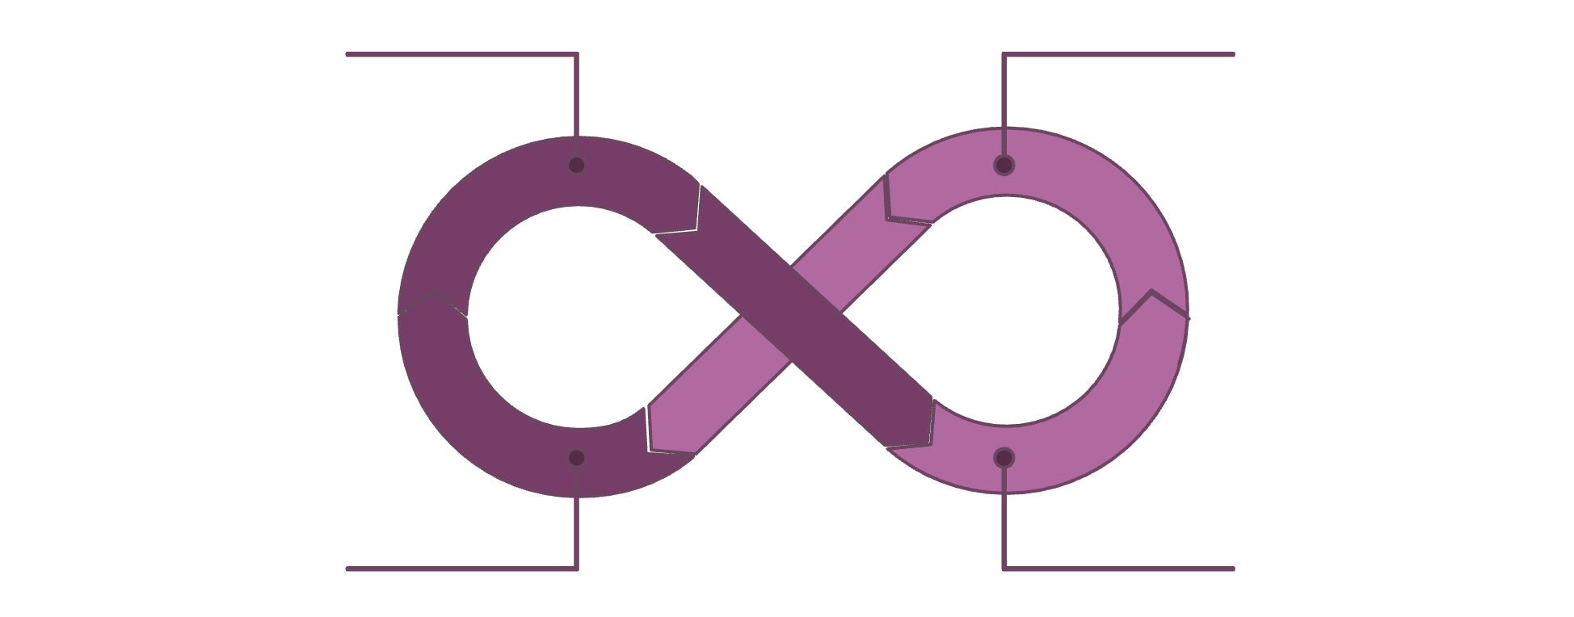
What Are Loops in Dart?
Loops are fundamental control flow statements that allow you to execute a block of code repeatedly until a specified condition is met. They are essential for automating repetitive tasks and processing collections of data efficiently.
Condition Check
Enter Loop
Repeat Cycle
Code Block
This mechanism prevents redundant code and makes your programs more concise and maintainable.

Slide 3
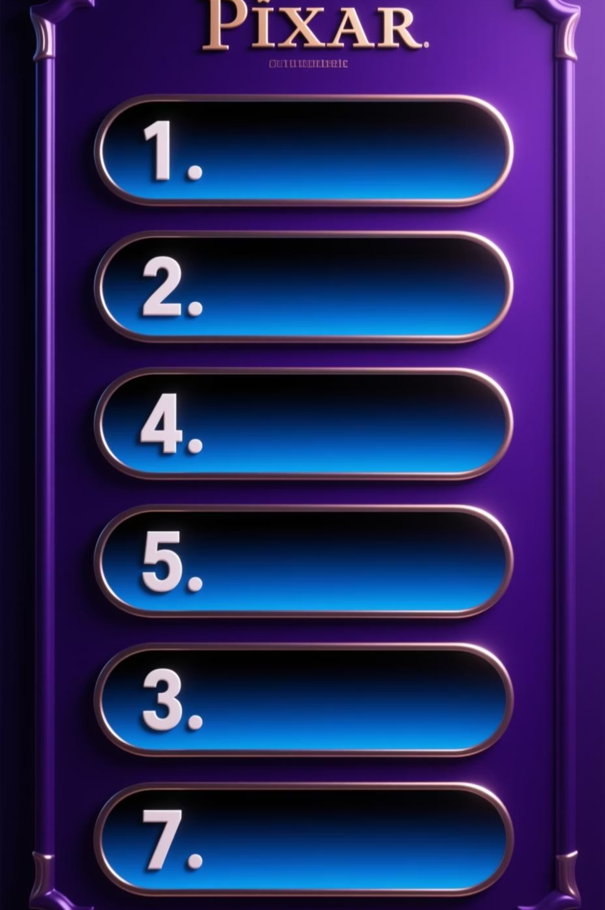
The for Loop in Dart
The for loop is used when you know exactly how many times you want to iterate over a block of code. It's perfect for fixed-number repetitions.
for (var i = 0; i < 5; i++) {
print(i);
}
1
2
Initializer
Condition
Executed once at the beginning to set up the loop variable (e.g., var i = 0;).
Checked before each iteration. If true, the loop continues; if false, it terminates (e.g., i < 5;).
3
Increment/Decrement
Executed after each iteration to update the loop variable (e.g., i++;).

Slide 4

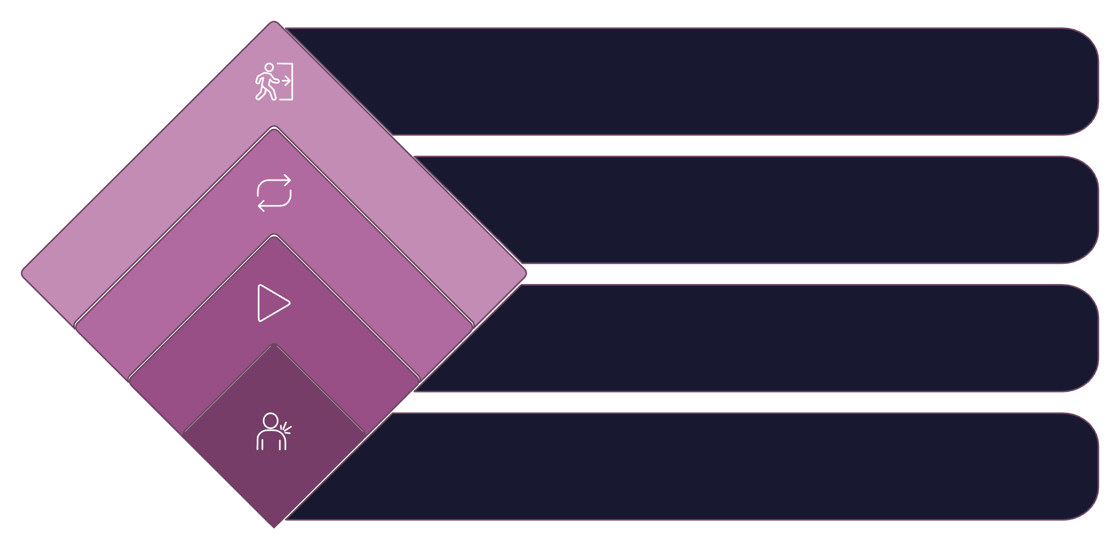

The while Loop in Dart
The while loop repeatedly executes a block of code as long as a specified boolean condition evaluates to true. It's ideal when the number of iterations isn't known beforehand.
var x = 0;
while (x < 3) {
print(x);
x++;
}
False: Exit
Exit the loop
Loop Back
Re-check condition
True: Execute
Run code block
Condition Check
Evaluate boolean expression
The condition is evaluated before each loop execution. If the condition is initially false, the loop body will never execute.

Slide 5

The do-while Loop in Dart
Unlike the while loop, the do-while loop guarantees that the code block is executed at least once, before the condition is evaluated. The loop continues as long as the condition remains true.
var n = 0;
do {
print(n);
n++;
} while (n < 3);
Run Once First!
The code block inside do is always executed at least once, even if the while condition is initially false.
Condition Check
After the first execution, the while condition is checked. If true, the loop repeats; otherwise, it exits.

Slide 6

Practical Loop Use Cases
Loops are versatile tools in Dart programming, essential for handling various repetitive tasks and data processing. Here are some common applications:
Iterating Collections
Easily process each item in a list, map, or set.
Repeating Tasks
Automate actions like retrying network requests or generating sequential data.
Reading Input
Continuously accept user input until a specific command is given.
Animations & Counters
Create smooth visual changes or track progress in games/applications.
Example: Iterating a list of fruits:
var fruits = ['apple', 'banana', 'cherry'];
for (var fruit in fruits) {
print('I love $fruit!');
}

Slide 7

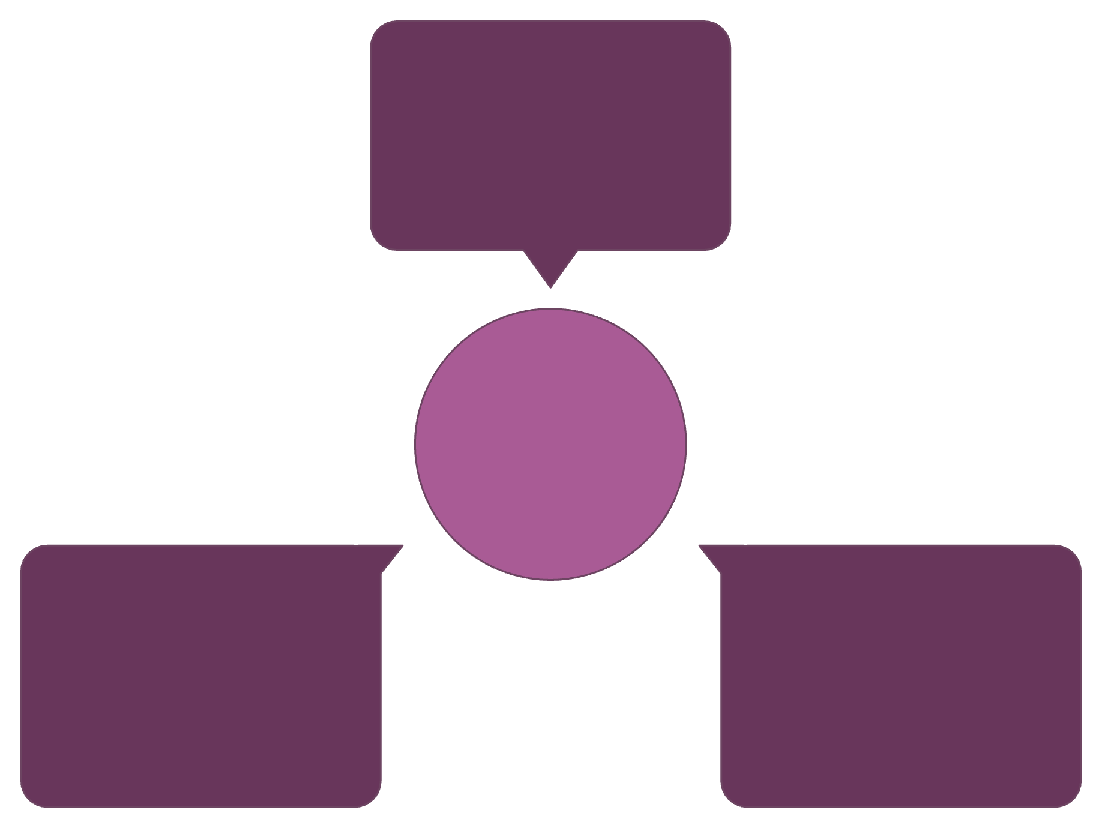
What Are Functions in Dart?
A function is a self-contained block of code designed to perform a specific task. They are crucial for organizing code, promoting reusability, and making programs easier to understand and debug.
Input
Data passed into function
Function Flow
Output
Function Block
Result returned from function
Encapsulated Dart logic
By encapsulating logic within functions, you can avoid repetition and build modular, scalable applications.

Slide 8

Defining Functions in Dart
Defining a function involves specifying its name, parameters (if any), and the code it will execute. Functions can return a value or perform actions without returning anything.
void greet() {
print('Hello!');
}
void Keyword
Indicates that the function does not return any value. If a value is returned, its data type replaces void.
Function Name
A descriptive name that follows naming conventions. This name is used to call the function.
Parentheses ()
Used to enclose parameters, even if there are none, as in greet().
To execute the function, simply call it by its name: greet();

Slide 9

Functions with Parameters & Return Values
Functions become much more powerful when they can accept input values (parameters) and produce output (return values). This allows for dynamic and flexible operations.
int add(int a, int b) {
return a + b;
}
Parameters as Input
Return Type
Return Statement
a and b are parameters that act as local variables within the function, receiving values when the function is called.
The int before add specifies that this function will return an integer value.
The return keyword sends a value back to the caller of the function.
Example call: var sum = add(5, 3); // sum will be 8

Slide 10

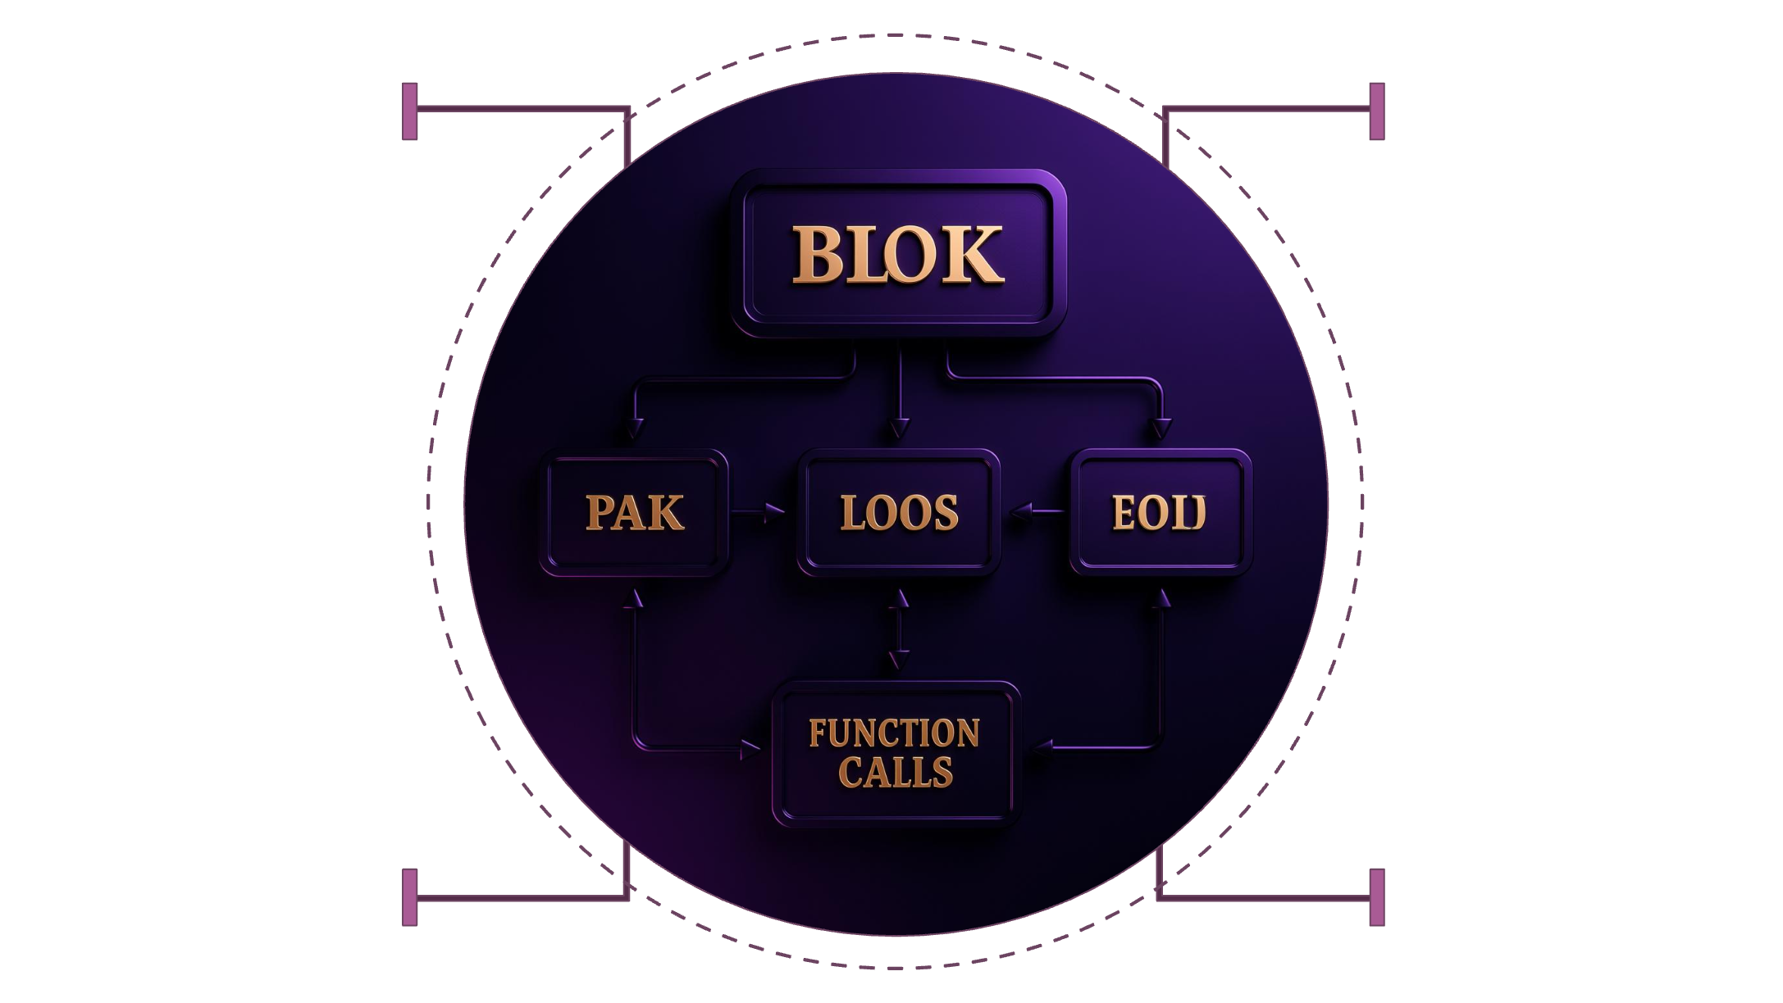
Basic Dart Program Structure
Every executable Dart program starts with a main function, which serves as the entry point. It orchestrates the flow, calling other functions and controlling program logic.
void main() {
// Declare variables here
var name = 'Dart Learner';
// Use loops for repetition
for (var i = 0; i < 2; i++) {
print('Iteration $i');
}
// Call other functions
greet(); // from Slide 8
var result = add(10, 20); // from Slide 9
print('Result: $result');
}
main()
Variables
Program entry and flow control
Store and manage data
Loops
Repeat actions over data
Function Calls
Invoke reusable code
Understanding this structure is key to building well-organized and functional Dart applications.

